Slide 1
Saint Patrick’s day

Slide 2
Saint Patrick is the patron of Ireland

Slide 3
Saint Patrick is one of the most popular saints in the world. He was born available in 385 in Great Britain. At 16, the boy was kidnapped and then transported to Ireland, where as a slave he grazed sheep.

Slide 4
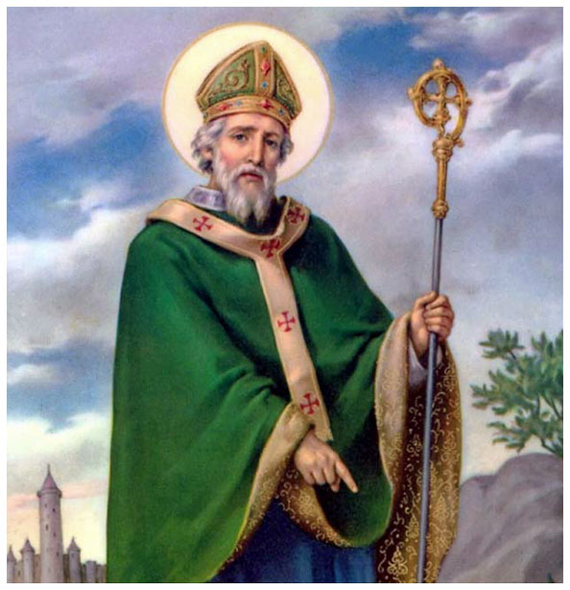
Many people think that he was born in Ireland, but that's not true. He was born most likely in Wales.

Slide 5
Shamrock – three-leaf clover

Slide 6
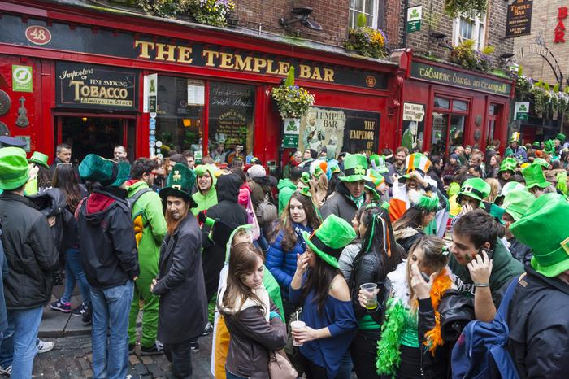
People celebrate St. Patrick’s day by dressing up green clothes with shamrocks and drinking green drinks and beer ( everything is green )

Slide 7
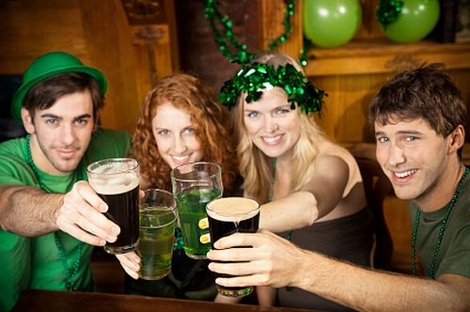
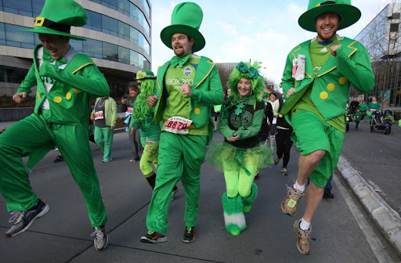
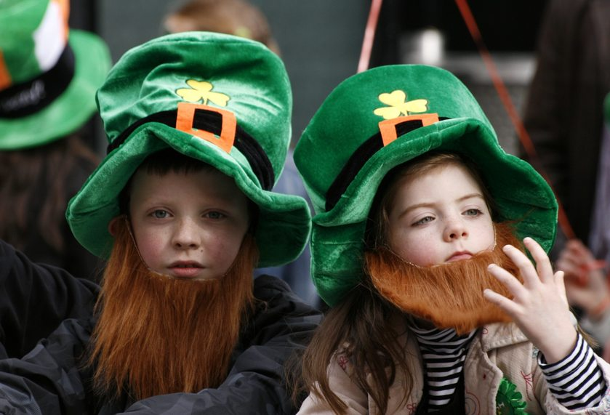
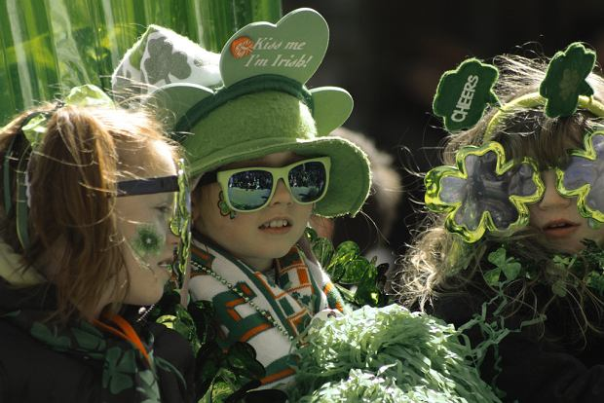

Slide 8
St. Patrick’s day is also celebrated in : - Poland - United States of America

Slide 9
St. Patrick is often depicted in an animated version

Slide 10
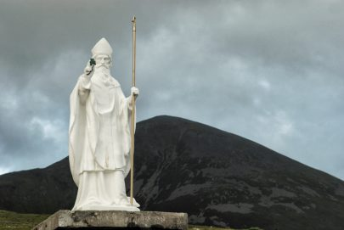
There are many monuments to St. Patrick's in Ireland

